Slide 1

Analysis of Retail Sales Data
This presentation outlines a comprehensive analysis of retail sales data, covering everything from initial exploration and cleaning to feature engineering and interactive dashboard deployment. Our goal is to transform raw transaction records into actionable insights for data-driven business decisions.

Slide 2
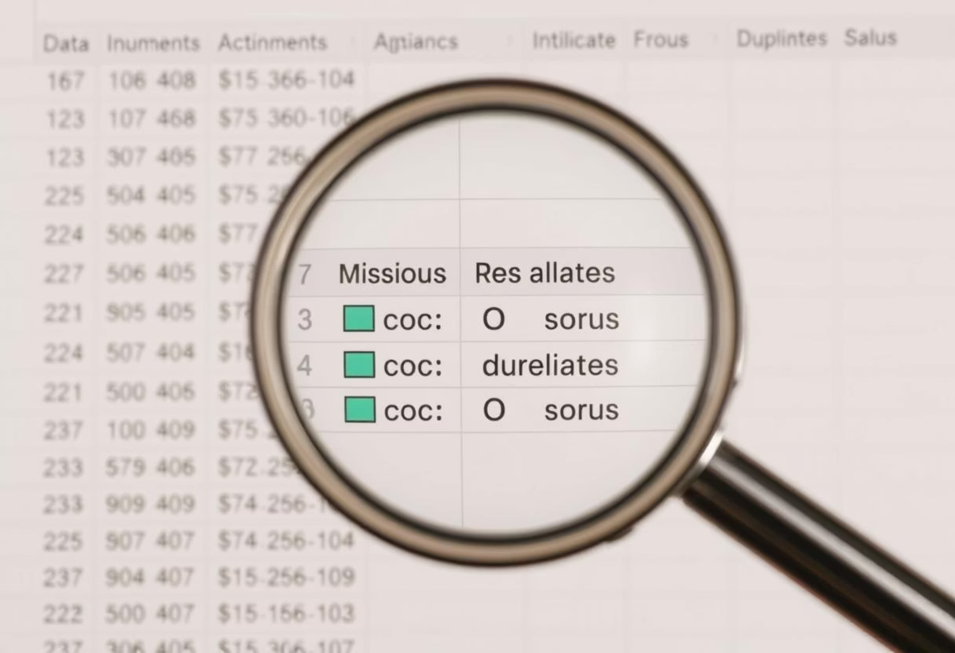
Introduction and Data Exploration
Dataset Overview
Analysis Goals
The retail sales dataset includes customer ID, items, category, transaction dates, payment methods, discounts, total spending, and location.
Our objectives are to explore, clean, preprocess, engineer features, and deploy an interactive visualization dashboard.
Data Exploration Findings
Missing Values: Approximately 5% of numerical data was identified as missing.
Duplicates: No duplicate records were found in the dataset.

Slide 3

Data Cleaning Strategies
To ensure the data was ready for in-depth analysis, we implemented specific cleaning steps for both categorical and numerical variables. These steps were crucial for maintaining data integrity and consistency.
Categorical Data Handling
Grouped variables like 'Category', 'Payment Method', 'Location', and 'Discount Applied' into a structured format for easier analysis.
Numerical Data Handling
Ensured numerical columns such as 'Total Spent' and 'Quantity' were correctly formatted, preparing them for quantitative analysis.

Slide 4



Feature Engineering from Transaction Dates
To extract deeper insights and analyze sales trends more effectively, we engineered several new features from the 'Transaction Date' column. This process enriches the dataset for time-series analysis.
Day & Day of Week
Weekend Indicator
Extracted the specific day and day of the week for granular analysis.
A boolean feature indicating if the transaction occurred on a Saturday or Sunday.
Month, Quarter & Year
Derived month, quarter, and year to analyze sales performance over different periods.

Slide 5
Data Preprocessing for Predictive Analysis
Before proceeding with any modeling, the data underwent a rigorous preprocessing phase. This involved addressing missing values and encoding categorical variables to prepare the dataset for predictive analysis.
Handling Missing Values
Encoding Categorical Variables
Numerical Data: Missing values (5%) were filled using the mean.
One-Hot Encoding: Applied to 'Category', 'Payment Method', 'Location', and 'Discount Applied'.
Categorical Data: Missing values were imputed with the mode (most frequent category).
Binary Encoding: Used for the 'Item' column to reduce dimensionality.

Slide 6
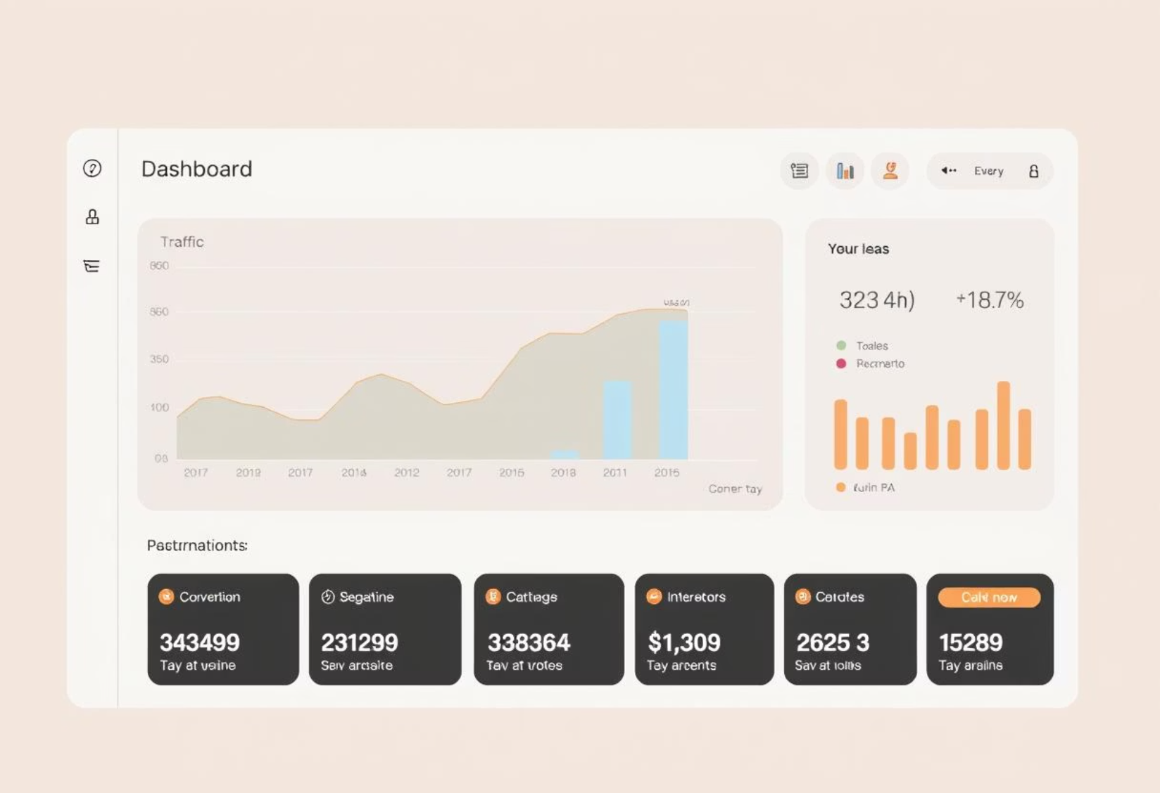
Target Variable and Dashboard Deployment
Target Variable
For our predictive analysis, 'Total Spent' was designated as the target variable. This allows us to focus on forecasting spending patterns.
Deployment Phase: Streamlit App
An interactive Streamlit application was developed to visualize the insights derived from the analysis. This dashboard provides a dynamic way to explore the data.

Slide 7
Interactive Dashboard Sections
The Streamlit application is designed with distinct sections to facilitate comprehensive data exploration, allowing users to delve into various aspects of the retail sales data.
Univariate Analysis
Examines the distribution of individual variables, such as sales by category, providing insights into single data points.
Bivariate Analysis
Explores relationships between two variables, for example, sales versus location, to identify correlations and patterns.
Multivariate Analysis
Investigates interactions among multiple variables, like sales trends over time by category, for a holistic view.

Slide 8
Deployment Challenges and Solutions
Deploying the interactive Streamlit dashboard presented a unique challenge due to the development environment. We implemented a specific solution to ensure accessibility.
The Challenge: Google Colab
Developing in Google Colab meant that local hosting of the Streamlit app was not directly supported, limiting immediate access.
The Solution: Pyngrok
To overcome this, Pyngrok was utilized to create a temporary public URL. This allowed seamless access to the Streamlit dashboard from any location.

Slide 9

Conclusion and Future Enhancements
This analysis provided a structured approach to understanding retail sales data, from raw transactions to interactive visualizations. The deployed Streamlit dashboard empowers businesses with data-driven insights.
Key Takeaway
Future Enhancements
The project successfully explored, cleaned, preprocessed, and visualized retail sales data, enabling interactive trend analysis.
Future work could include predictive modeling for sales forecasting, further enhancing decision-making capabilities.

